Slide 1


Mortality Risk

Slide 2


Manish Kumar
LinkedIn URL – linkedin.com/in/manishkumar386
Git Repository – https://github.com/manish04031988

Slide 3


Project Goals
Objectives
Constraints
Minimize Mortality Risk of a Patient when admitted.
Maximize and improve triaging, bed and resource allocation, and improved patient management throughout health systems
Data Provided is in Categorical format.
Data Provided in numerous columns 83 columns.
Data Missing in few of the Columns.

Slide 4
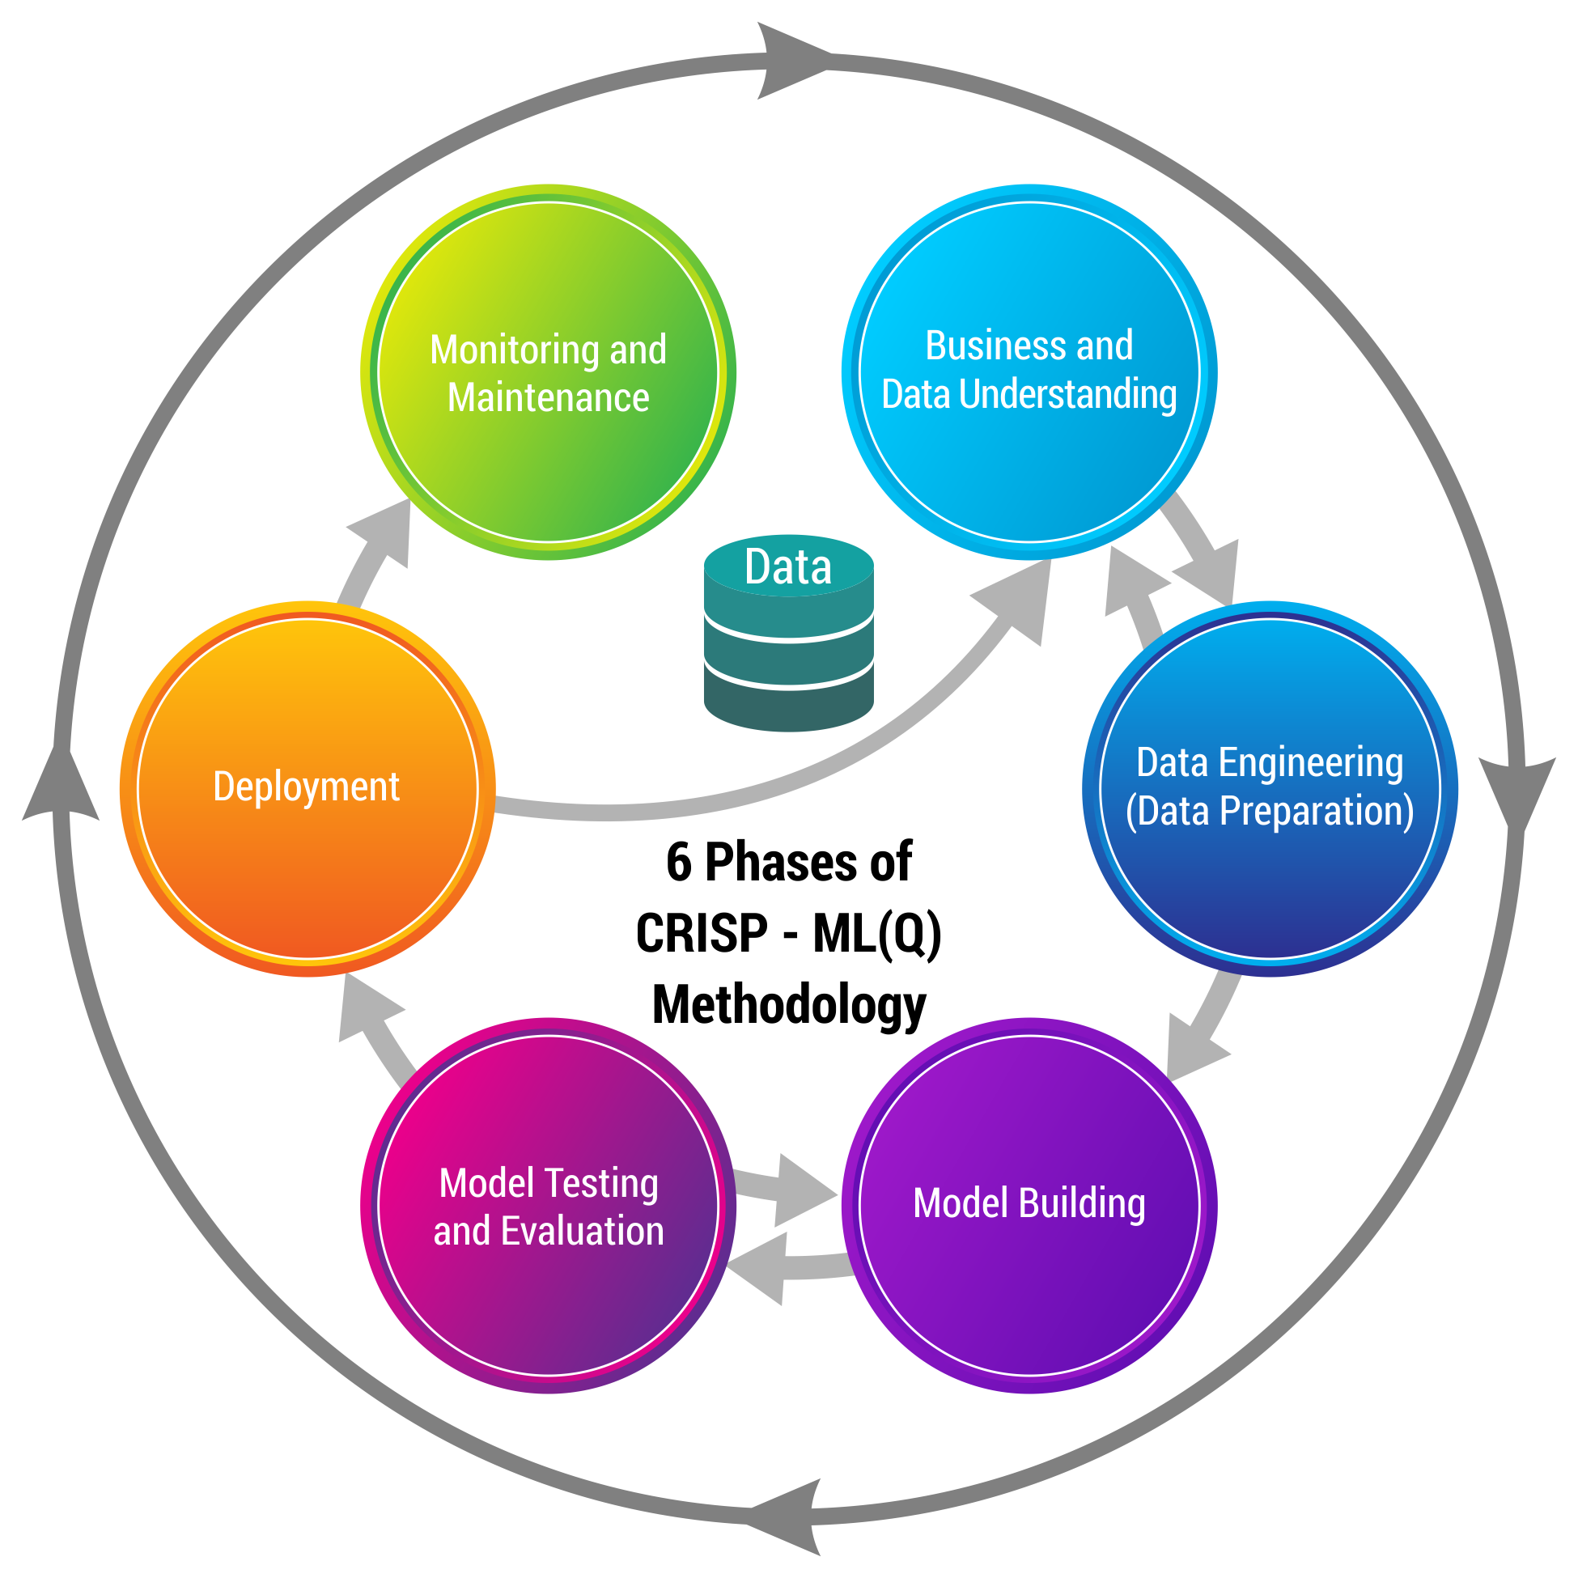
Business pipeline: CRISP-ML(Q) Methodology

Slide 5








Technical Stacks
Python, Google Colab, Pandas, Numpy, sklearn, SelectKBest, Chi2, ExtraTreesClassifier

Slide 6
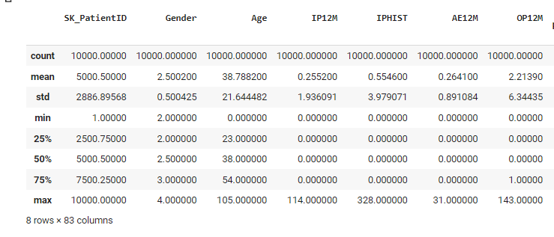
Project Architecture / Data Pipeline
Data Cleansing : Removed Columns which had very less number of data points.
Preparation : Dropped columns which has high variance and which are not useful in the Data Modeling. Ex : SK_PatientID, GP_PRACTICE
EDA : Performed EDA for the Data set. Please see screenshot.
Feature Engineering on Categorical Data through Encoding Categorical Features.

Slide 7

Data Preparation
Data provided.
Data cleansing : Cleaned data by removing multiple columns which had only one records.
Understood each and every columns meaning and Tests which are used to diagnose diseases.

Slide 8

Model Building

Slide 9
Model Description
Algorithms used:
Logistic Regression
Applied SelectKBest class to extract Top 20 Features.
Feature scoring for each column
Decision Tree with ‘5’ trees
Descriptions:
Split the data into training (70%) & testing (30%)
Regularization techniques used: k value in KNN; # of tree in Decision Tree

Slide 10
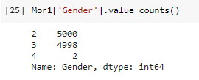
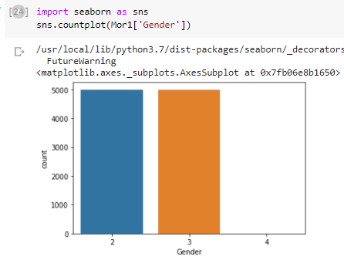
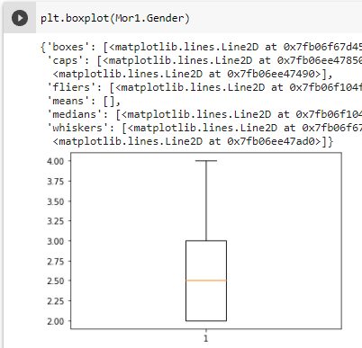
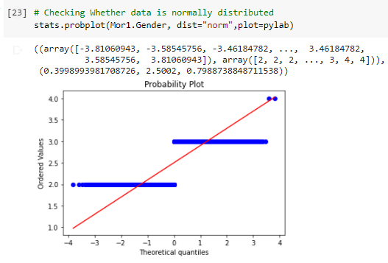
Model Description
Performed EDA on each columns with Bar Graph and Box Plot.
Gender Graphs :

Slide 11
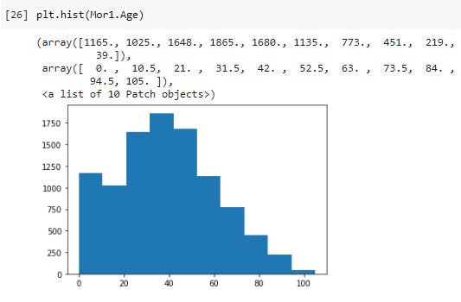
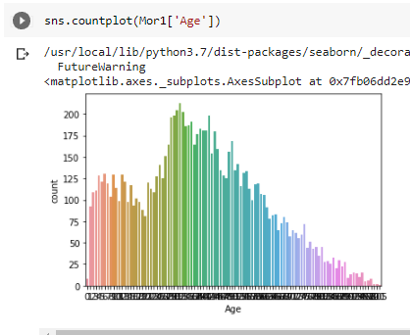
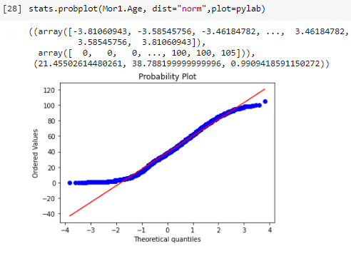
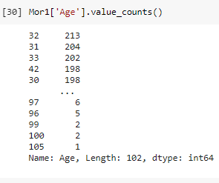
Model Description
Performed EDA on each columns with Bar Graph and Box Plot.
Age Graphs :

Slide 12
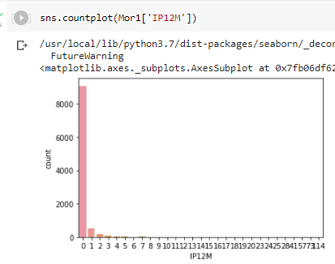
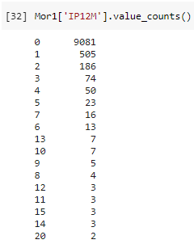
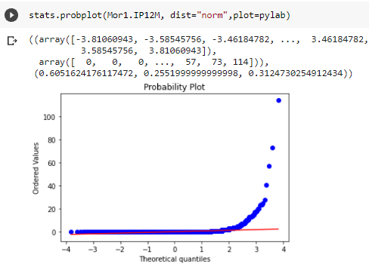
Model Description
Performed EDA on each columns with Bar Graph and Box Plot.
IP12M Graphs :

Slide 13
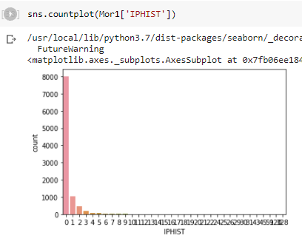
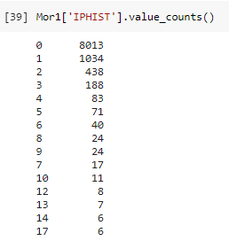
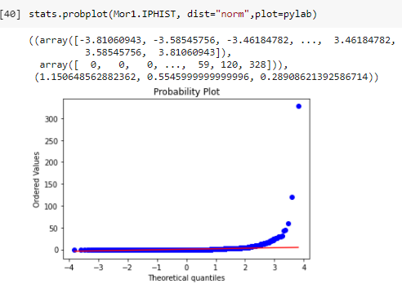
Model Description
Performed EDA on each columns with Bar Graph and Box Plot.
IPHIST Graphs :

Slide 14
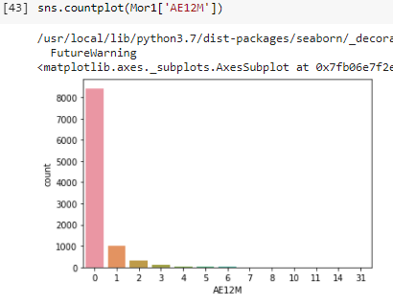
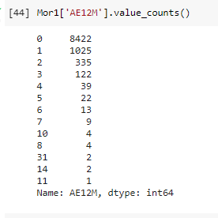
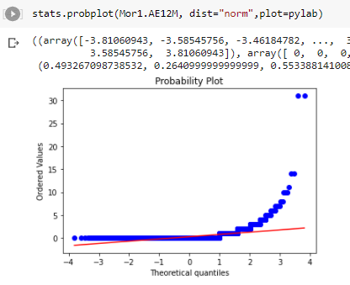
Model Description
Performed EDA on each columns with Bar Graph and Box Plot.
AE12M Graphs :

Slide 15
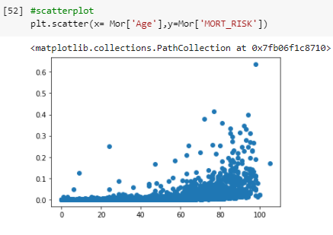
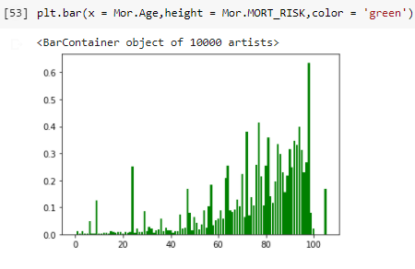
Model Description
AGE vs MORT_RISK

Slide 16
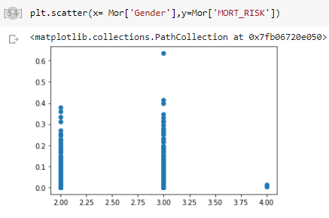
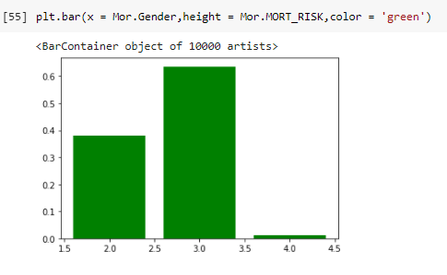
Model Description
GENDER vs MORT_RISK

Slide 17
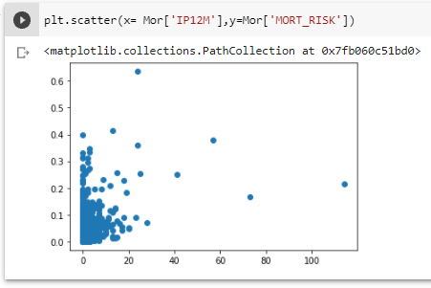
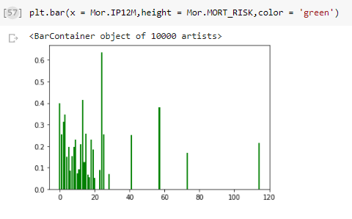
Model Description
IP12M vs MORT_RISK

Slide 18
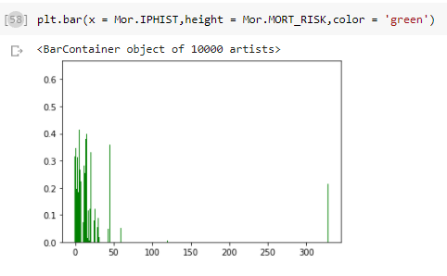
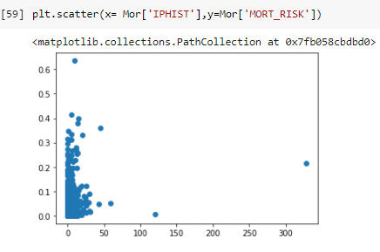
Model Description
IPHIST vs MORT_RISK

Slide 19
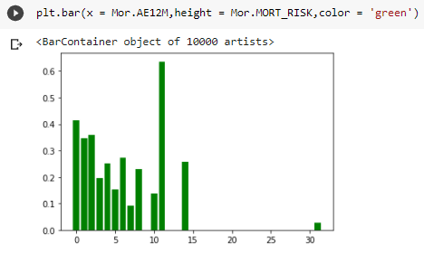
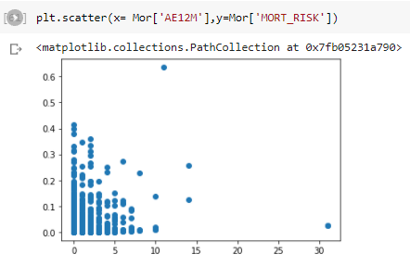
Model Description
AE12M vs MORT_RISK

Slide 20
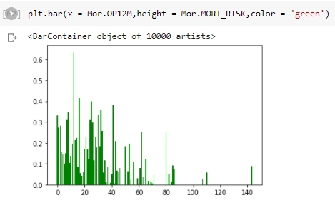
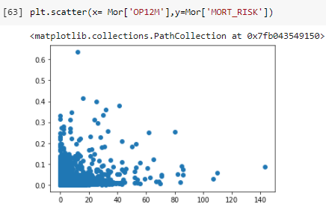
Model Description
OP12M vs MORT_RISK

Slide 21
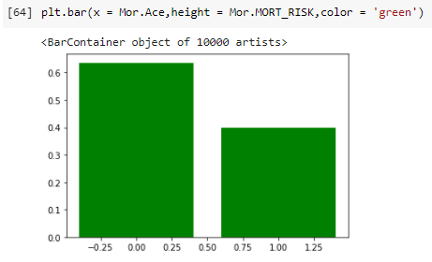
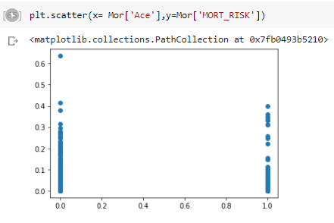
Model Description
ACE vs MORT_RISK

Slide 22
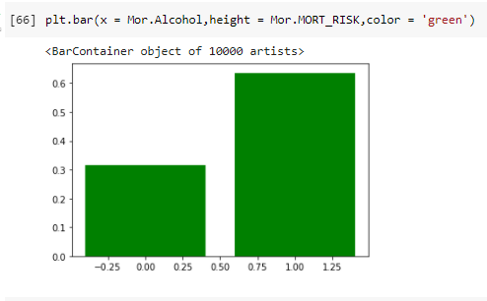
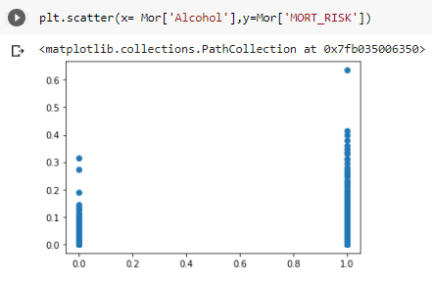
Model Description
ALCOHOL vs MORT_RISK

Slide 23
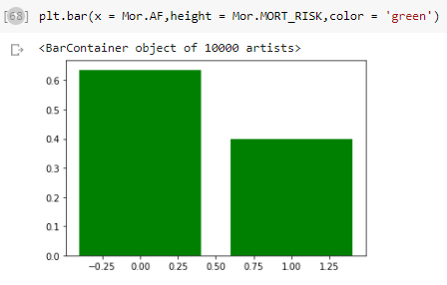
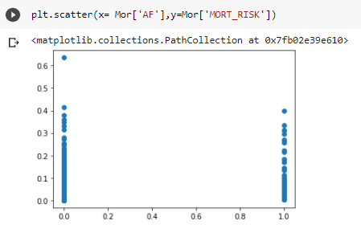
Model Description
AF vs MORT_RISK

Slide 24
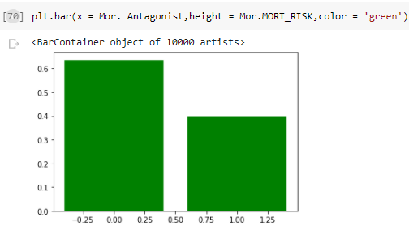
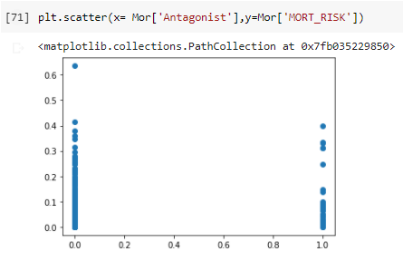
Model Description
ANTAGONIST vs MORT_RISK

Slide 25
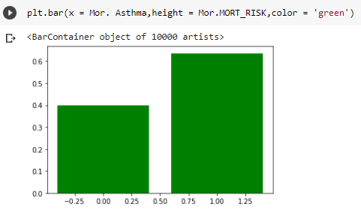
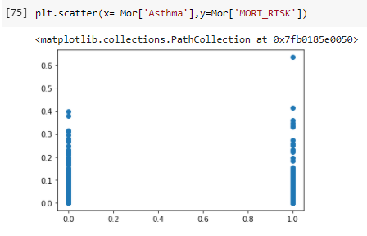
Model Description
ASTHMA vs MORT_RISK

Slide 26
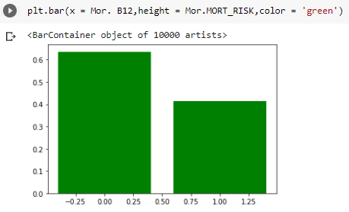
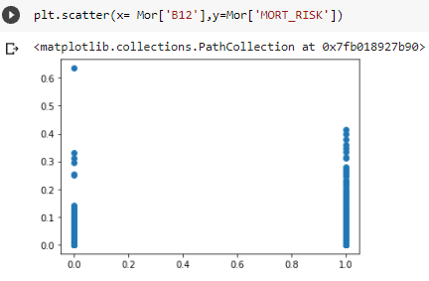
Model Description
B12 vs MORT_RISK

Slide 27
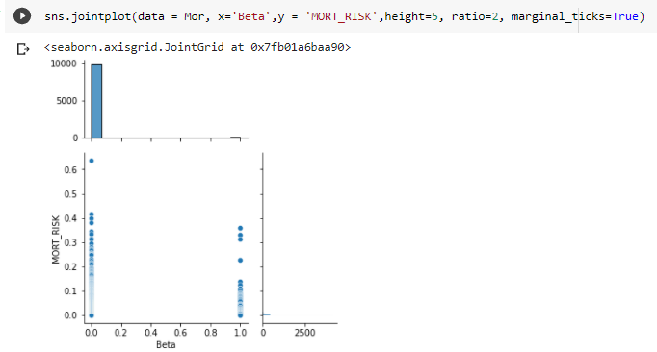
Model Description
BETA vs MORT_RISK

Slide 28
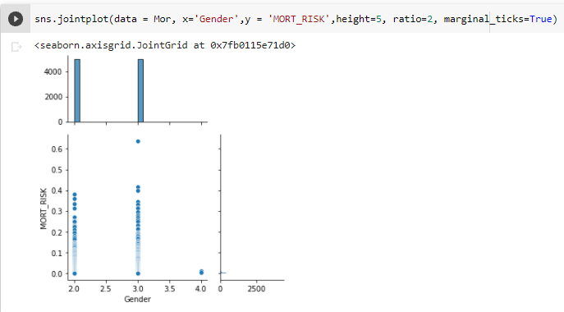
Model Description
GENDER vs MORT_RISK

Slide 29
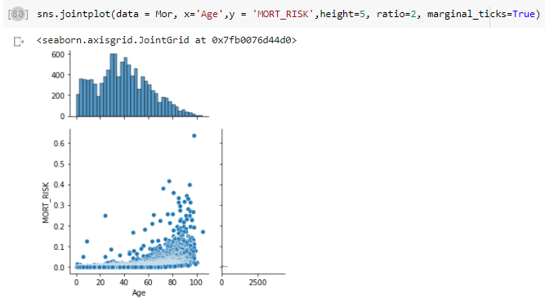
Model Description
AGE vs MORT_RISK

Slide 30
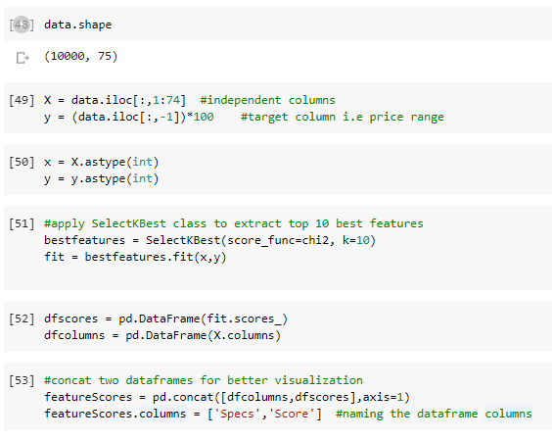
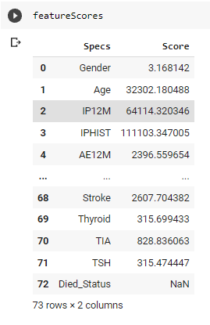
Outputs of the Model in Codes
FEATURE SELECTION :

Slide 31
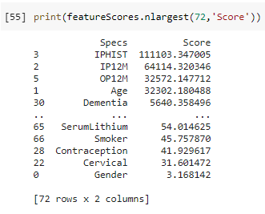
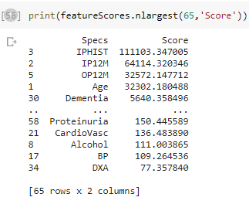
Outputs of the Model in Codes
FEATURE SELECTION : Largest 72
FEATURE SELECTION : Largest 65

Slide 32


Outputs of the Model in Codes
FEATURE SELECTION : Largest 50
FEATURE SELECTION : Largest 20

Slide 33


Outputs of the Model in Codes
Feature Importance :

Slide 34

Outputs of the Model in Codes
Plot graph of feature importances :

Slide 35

Correlation Matrix with Heatmap

Slide 36

Correlation matrix only for the top 50 features affecting

Slide 37

Feature Score for the top 20 features affecting
Scores of feature importances :

Slide 38

Correlation matrix only for the top 20 features affecting

Slide 39

Correlation matrix only for the top 20 features affecting

Slide 40
Model Performance output
Heart Related Disease or Tests perfomed with patient has more risk compared to other related Diseases.
AF vs Stroke has the maximum number to Mortality Risk followed by LVSD, Hypertension, IPHIST, CKD, CANCER, CHD etc

Slide 41

Deployment Strategy
Web Based
Mobile Based
Cloud Based
Enterprise Based

Slide 42


